Slide 1
Food Sales Analysis

Slide 2
Title and Content Layout
Introduction
Objectives
Statement Of Problem
Dashboard Overview
Key Insights
Recommendations
Summary

Slide 3
INTRODUCTION
Let's talk about where we stand as a business. We've put together this sales report because understanding our numbers isn't just about celebrating wins it's about making smarter decisions that keep us growing and competitive.
Right now, we're doing 7 million in revenue with 298 customers spread across four regions: West, North, East, and South. We sell six main products across three categories: Food, Staples, and Drinks. Pretty straightforward, right? But when you dig into the details, some interesting patterns emerge.
This dashboard tells our story: What's working really well, where we're leaving money on the table, and honestly, where we need to step up our game. We're looking at everything from which regions are crushing it to which customers are keeping our lights on, and whether our product mix is actually serving us or if we could do better.
The goal here isn't just to present numbers it's to have an honest conversation about our business so we can make the right moves going forward.

Slide 4
OBJECTIVES
Here's what we're trying to figure out with this analysis:
Get a clear picture of how we're really doing : Beyond just the headline revenue number, we want to understand if our sales engine is healthy or if there are warning signs we're missing.
Understand why some regions are winning and others aren’t : The West is killing it, but the South? Not so much. We need to know why and what we can do about it.
Find the leaks in our system : Money that's "pending" is money we haven't collected yet. What's causing the delays, and how do we fix it?
Walk away with a game plan : Numbers are nice, but we need actionable steps we can take tomorrow to improve our business.

Slide 5
STATEMENT OF PROBLEM
Our revenue is concentrated in the hands of too few customers. When you look at that customer chart, you see names like Bridget Diaz, Dawn Williams, and Shannon Craig carrying massive portions of our business. With only 298 total customers generating 7 million, basic math tells us that our top 20-30 customers probably account for more than half our revenue.
Three Regions Are Underperforming and we don’t know why, the West region is crushing it while the South, East, and North are leaving millions on the table. Look at that regional revenue chart the West is pulling in nearly 6M while the South barely hits 3.5M. That's not a small gap; that's almost a 2-to-1 difference.
We’re earning money we’re not collecting ,the pending revenue trend is a slow motion cash flow disaster. That line chart showing pending revenue declining from West (2.5M) to South (0.7M) isn't just interesting data it's a warning sign that our revenue collection system is broken in different ways across different regions. Let's be clear about what "pending revenue" means: it's money we've already earned, products we've already delivered, but cash we haven't actually received yet. It's sitting in limbo, not in our bank account where we can use it to buy inventory, pay employees, or invest in growth.

Slide 6
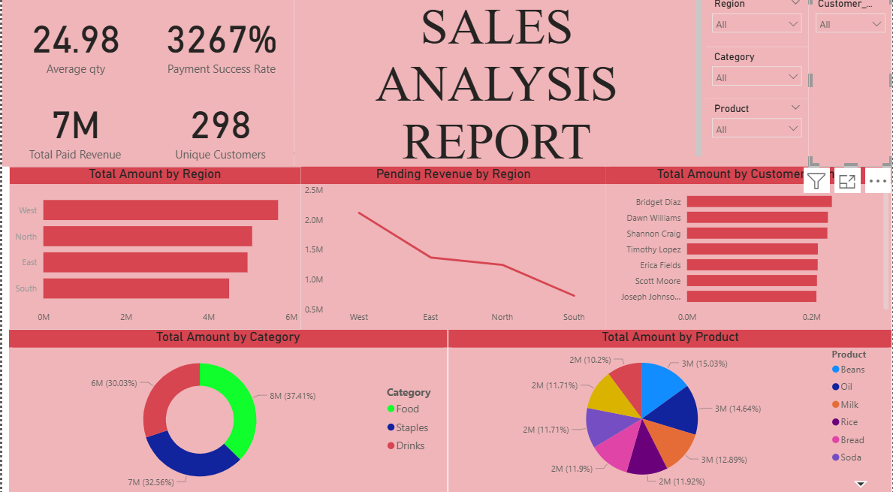
DASHBOARD OVERVIEW

Slide 7
KEY INSIGHTS
Overall Performance Snapshot: The business is showing some impressive numbers with 7M in total paid revenue from 298 unique customers.
Regional Performance: The West region is our clear winner, generating the most revenue, while the South lags behind. What's concerning is that "Pending Revenue by Region" chart showing a declining trend from West to South this suggests either payment delays or fulfillment issues that vary by geography.
Product & Category Mix: Food dominates our category sales at 37.41%, which makes sense if that's your core business. However, your product distribution is relatively balanced across Beans, Oil, Milk, Rice, Bread, and Soda (each ranging from about 11-15% of sales). This diversity is actually healthy we’re not overly dependent on any single product.
Customer Concentration: Our top customers (Bridget Diaz, Dawn Williams, Shannon Craig) are carrying significant weight in our revenue. While having strong relationships with key accounts is great, this concentration creates risk. If one or two of these customers reduce their orders, it could significantly impact our bottom line.

Slide 8
RECOMMENDATIONS
Diversify our customer base : With only 298 unique customers generating 7M, we have good average order values (around 24.98 per transaction based on average quantity).We need to consider a customer acquisition campaign to reduce dependency on our top accounts.
Address pending revenues : The downward trend in pending revenue by region suggests operational inefficiencies. We need to review our payment collection and fulfillment processes, especially in the East, North, and South regions.
Maintain our product balance : Our diversified product mix is working well. We don’t need to over pivot unless we see clear opportunities for margin improvement in specific categories. The foundation is solid, but there's definitely room to tighten operations and reduce risk through customer diversification.
Investigate regional disparities : We need to figure out why the South is underperforming? Is it market penetration, logistics costs, competition, or something else? Similarly, understand what's working in the West so we can replicate it.

Slide 9
SUMMARY
The good news is we've hit 7 million in revenue with 298 customers, which means each customer is worth serious money to us averaging about 25 units per transaction. That's actually impressive. We're not chasing pennies; we're building real relationships with customers who buy in volume.
The path forward is clear, what we need to do is fix our tracking so we actually know what's happening, launch a serious customer acquisition push to spread our risk, get to the bottom of why the South and other regions aren't performing like the West, tighten up our payment collection processes everywhere, and keep doing what's working with our product mix while staying alert for ways to improve margins.
We've built something solid here. Now we need to make it stronger and more resilient. This report lays out exactly how we're going to do that.

